Slide 1
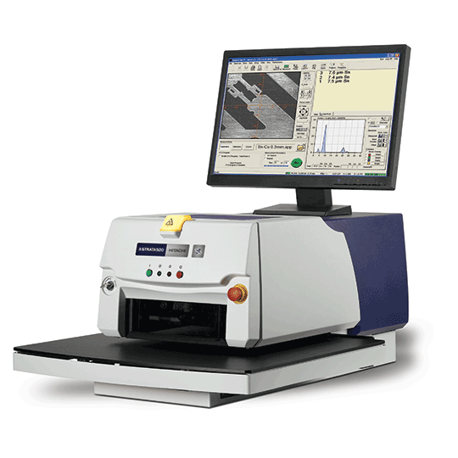
X-Strata920
Easy XRF coatings analysis

Slide 2

Hitachi High-Tech
Hitachi Instruments Group
Hitachi Semiconductor Manufacturing Equipment Group
Nissei Sangyo
(Established 2001)
Member of the Hitachi group of companies and trading on the Tokyo Stock Exchange
with over 10,000 employees and revenues of 645 billion yen in FY2016
Vision | To consistently aim to be Global Top in high-tech solutions
Mission | To turn our customers into fast-moving, cutting-edge businesses
Industrial Systems
Social infrastructure Industrial infrastructure ICT solutions
Science & Medical Systems
Electron microscopes Scientific instruments Medical products Biotechnology products
Electronic Device Systems
Process equipment Metrology & Inspection equipment
Advanced Industrial Products
Industrial materials Electronics materials Value Chain solutions
(HHA)

Slide 3
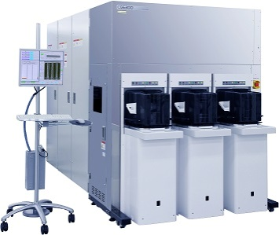
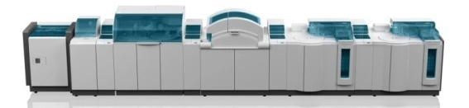
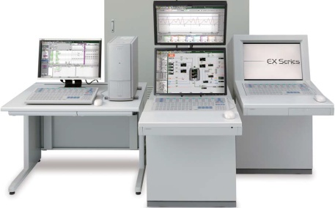
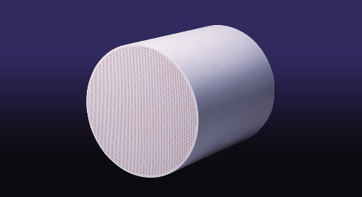
Hitachi High-Tech segments
Science & Medical Systems
Electronic Device Systems
■Electron Microscopes
■Scientific Instruments
■Medical Products
■Biotechnology Products, Others
■Process Equipment
■Metrology&Inspection Equipment
Industrial Systems
Advanced Industrial Products
■Social Infrastructure
■Industrial Infrastructure
■ICT Solutions
■Industrial Materials
■Electronics Materials
■Value Chain Solutions

Slide 4
Hitachi High-Tech Analytical Science (HHA)
Formerly the Industrial Analysis Division of Oxford Instruments - joined Hitachi High-Tech in June 2017
User-friendly smart science for materials analysis
Controlling quality and preventing fraud
Maximising use of scarce resources
Assuring regulatory compliance and safety
Enabling research and teaching

Slide 5













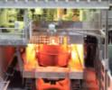



HHA markets
METALS - Production, Casting,
Fabrication and Scrap recycling
Cement and Limestone
Electronics
Mining and Soils
Precious Metals
and Jewellery
Ceramics and Nano-Composites
Power Generation
Consumer Product
Safety
Polymers, Plastics
and Rubber
Environmental
Aerospace and Automotive
Wood and Composites
Petroleum and Chemicals
Steel
Ink, Paint and Coatings
...and more!
Agriculture
Food

Slide 6
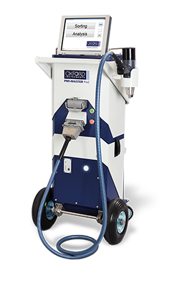
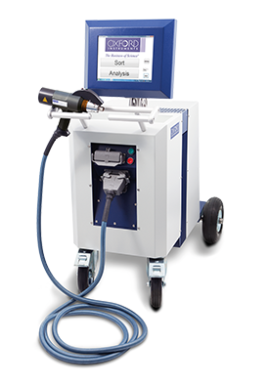
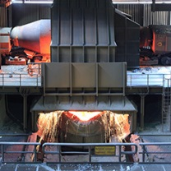
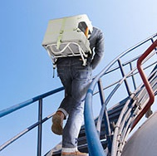
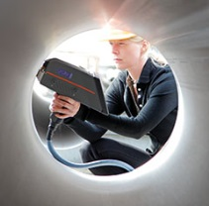

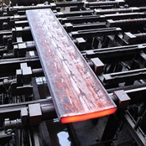
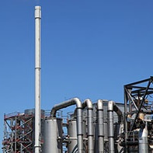
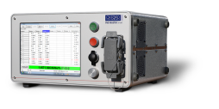
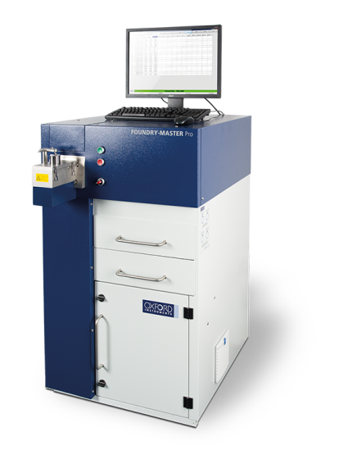

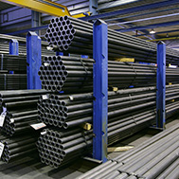

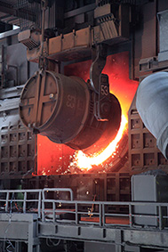
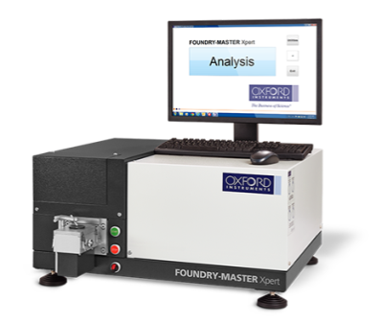
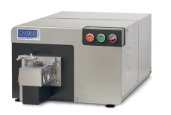
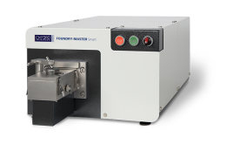
OES industries & applications
Metalworking
QA/QC, PMI
Metal sorting, recycling
Metals production
foundries
Non-ferrous metals, metals manufacturing, foundries

Slide 7
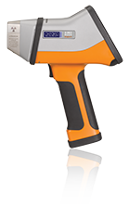
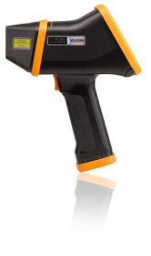
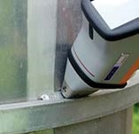
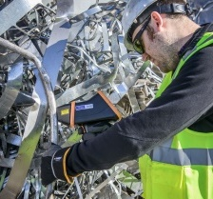
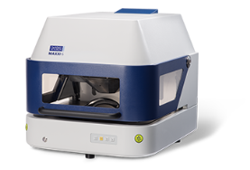
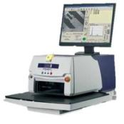


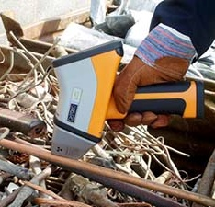
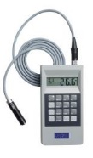


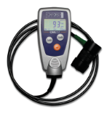
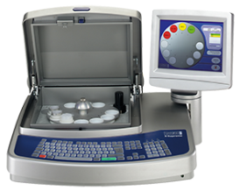
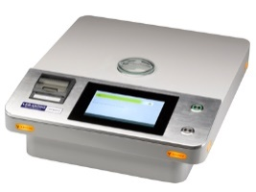


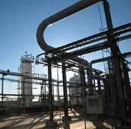
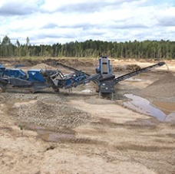


XRF & LIBS – industries & applications
Coating thickness / metal finishing
Electronics / precious metals
XRF
LIBS
PMI
Recycling
Mining
Chemical / Petro chemical
Mining, cement
Wood preservatives
Release liners

Slide 8

HHA global locations
Abingdon, UK HQ
Distribution Centre
Service & Support & Helpdesk
Uedem, Germany
OES Technology Centre
Coatings Technology
Production
Distribution Centre
Service, Support & Helpdesk
Espoo, Finland
XRF Technology Centre
LIBS Technology Centre
Westford, USA
Distribution Centre
Service, Support & Helpdesk
Sales Centres
China: Shanghai, Beijing, Guangzhou, Chengdu
Japan, Singapore, India
Czech Republic
+ Over 200 distributors world wide
Shanghai, China
XRF Production
Distribution Centre
Service, Support & Helpdesk
Backed up by Hitachi High-Tech
19 domestic branches in Japan
Global network in 23 countries / regions
and Hitachi Corporation

Slide 9
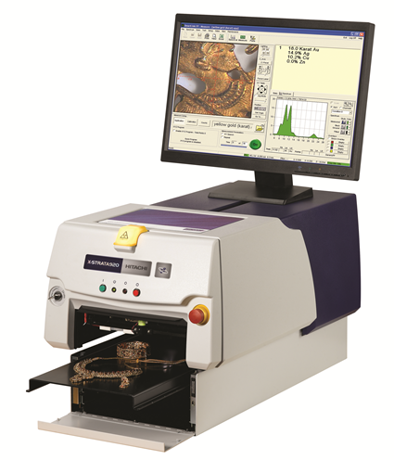
X-Strata920 overview

Slide 10
X-Strata920 overview
The X-Strata920 is a benchtop energy dispersive X-ray fluorescence (EDXRF) instrument for coatings and materials analysis in quality control and production control.
With reliable hardware and intuitive software, any operator can get reliable, high quality results with demanding testing requirements.

Slide 11
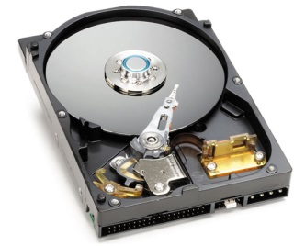
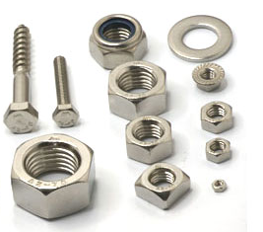

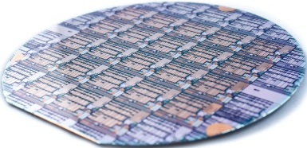
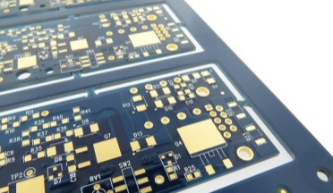
Coatings markets
World of coatings
Electronics
Metal finishing
Semiconductor
PCB
Components
Small parts
Large parts
The X-Strata920 is designed to measure a wide range of applications across many industries
Flexible chamber base configurations easily handle small parts, flat boards and taller components

Slide 12
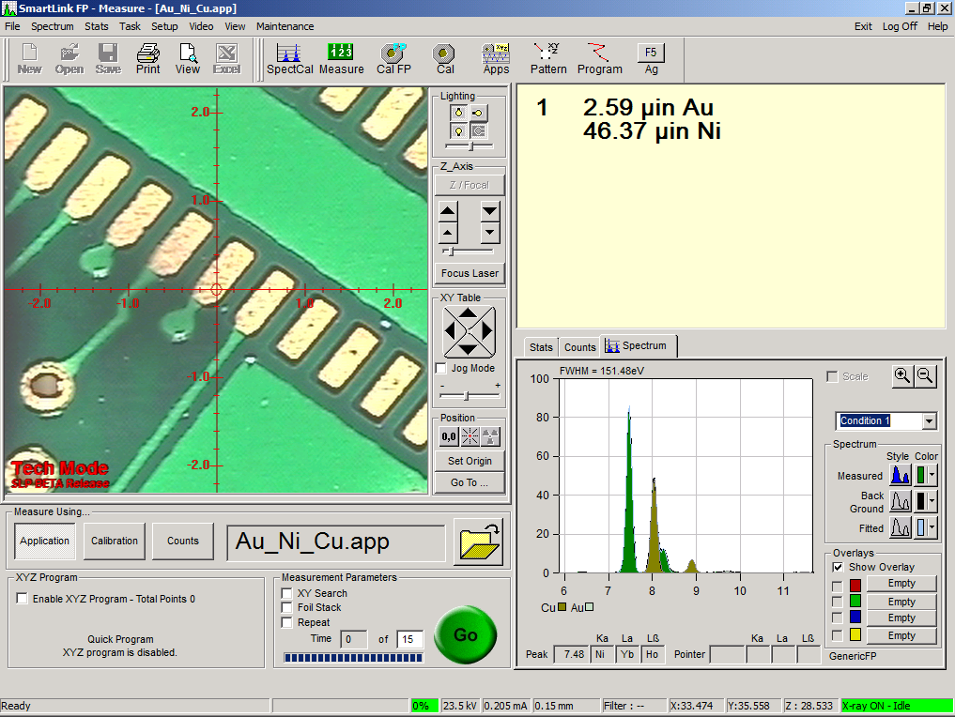
Intuitive SmartLink software
Single-screen interface displays results, sample view, measurement controls and available tasks
Choice of empirical or fundamental parameters (FP) coating calibrations
Create materials analysis calibrations including solution analysis with optional software packages
Runs on Windows 10

Slide 13
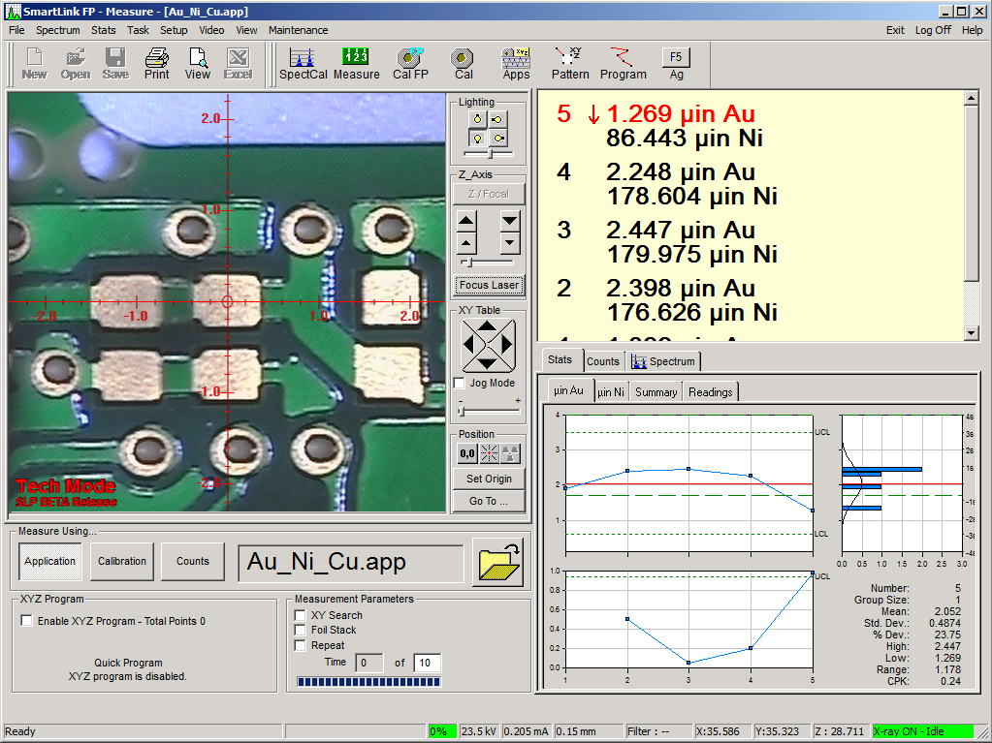
SmartLink – easy routine measurements
Results and statistics are easy to read and interpret
Pass/fail indicators
Running record of batch measurements
SPC quality data includes mean, standard deviation, high, low, Cpk
Clear view of the sample
Crosshair indicates precise measurement location
Zoom in for a closer view of small features
Simple operation
1 – position sample
2 – focus
3 – press the Go button

Slide 14
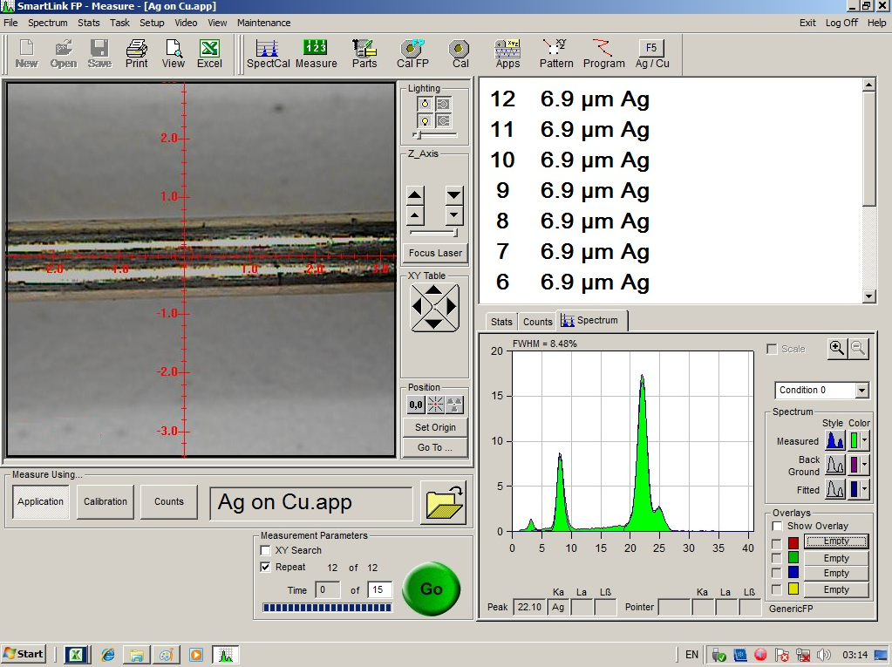
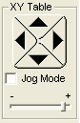
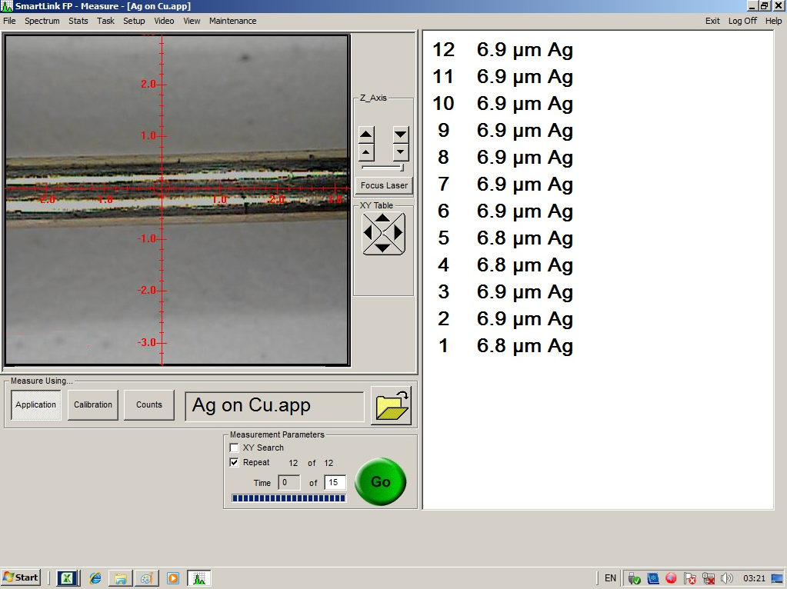
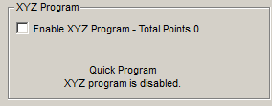
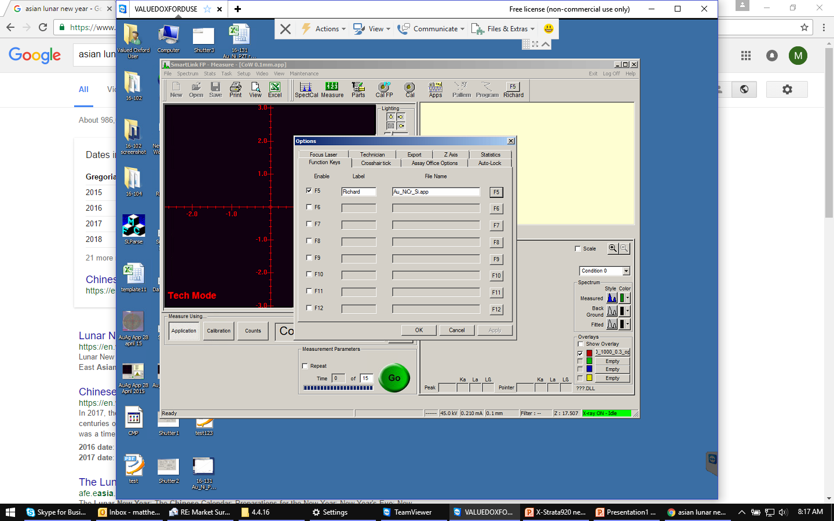
SmartLink – configurable measurement screen
Highlighted sections of the screen can be hidden
Improves visibility of results
Removes buttons and options
Operator sees only what is needed to take measurements
Example simplified screen with all configurable items removed

Slide 15
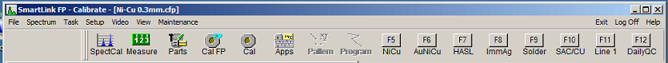
SmartLink – shortcuts keys
Define up to 8 shortcuts to quickly switch between common applications
Shortcuts are available at the top of the routine measurement screen
Shortcuts can also be activated by functions keys on the keyboards

Slide 16
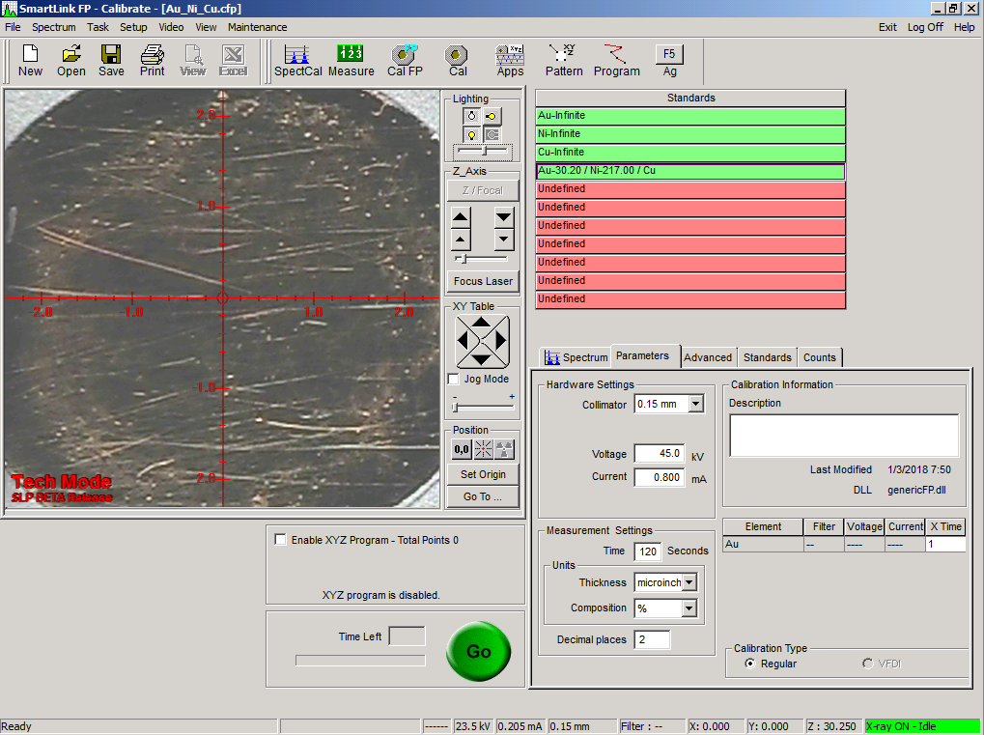
SmartLink – simple calibration setup
Pre-programmed routines makes it easy to calibrate
Select the elements and structure
Up to 4 layers plus base
Set parameters such as units, measurement time and decimal place
Define and measure standards or set up for standardless analysis

Slide 17
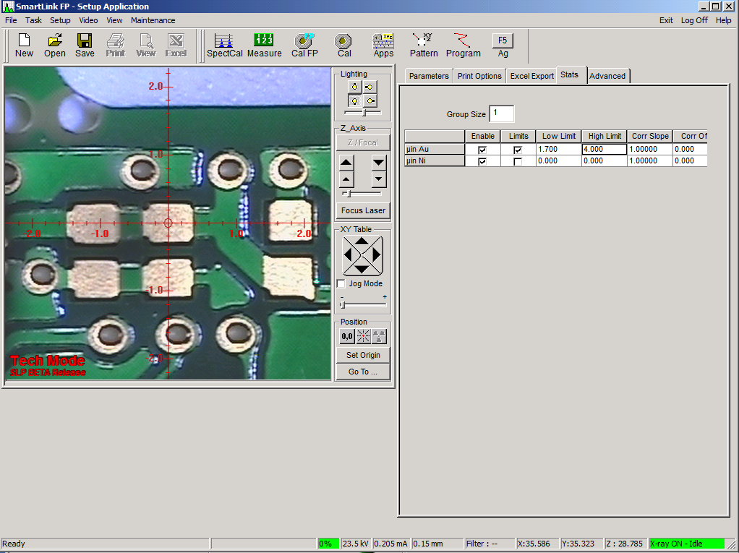
SmartLink – quick application setup
Create an application to define specific uses for a calibration
Choose how to export data
Enter high and low limits for each layer
Define density for phosphate coatings or soft gold
Select an automated XY program for routine parts

Slide 18
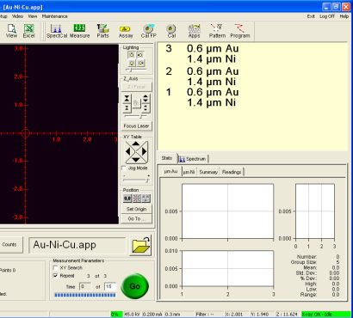
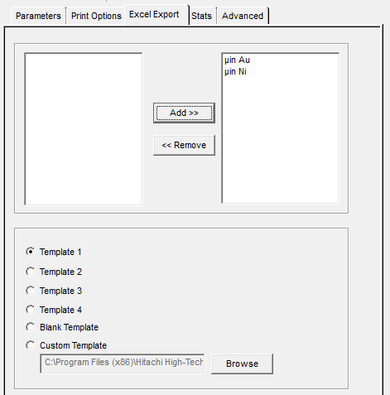

SmartLink – streamlined data handling
Create a report using SmartLink’s Statistics and Report Generator (SRG) or Excel
Simply click a button from the measurement screen to create the report
Default templates are provided

Slide 19


SmartLink – quick patterns
Automated patterns and programs for unattended operation of unique or routine samples
Scan areas to report an average over rough surfaces
Line and grid patterns
Adjust for sample orientation
Random points
Save for routine use or create quick programs from the measurement screen

Slide 20

SmartLink – detailed qualitative investigation
Convenient, simple tool to review production samples, unknown materials
Identify peaks
Collect region of interest (ROI) data
Compare up to 5 spectra

Slide 21


SmartLink – security features
Password protect the software to prevent unauthorised use
Access levels for basic operators and managers limits options for routine analysis by basic operators
Software can be set to log out after a user-defined amount of time

Slide 22

The right detector for your applications
Choose from a proportional counter or high resolution silicon drift detector (SDD)
Many applications can be done equally well with either detector
SDD has advantages for complex coatings and thinner coatings
HHA experts will help you decide which detector is best for your requirements
 | X-Strata920 Proportional counter | X-Strata920 SDD
Element range | Ti – U | Al – U
IPC-4552A |  | 
Complex coatings (eg. Cr/Ni/Cu/Zn) |  | 
Thin coatings |  | 
Analysis of neighboring elements | Sequential | Simultaneous

Slide 23


Selection of collimators to fit your parts
Optimize performance by choosing the collimator that best fits your samples
Single or multi-collimator configurations are available
Multi-collimator configuration allows up to 6 collimators
Choose from >15 collimators, including round and rectangular shapes
Cu
Ni
Br
Au

Slide 24
Chamber configurations to handle any part
The right chamber for the right sample
Programmable, motorised XY stage
Automated analysis for a series of samples or for multiple locations on a single sample
Standard table is 560 x 610 mm (22 x 24”) and has 178 x 178 mm (7 x 7”) travel
Compact table is 560 x 460 mm (22 x 18”) and has 101 x 178 mm (4 x 7”) travel

Slide 25
Chamber configurations to handle any part
The right chamber for the right sample
Mini-well
Flexible to handle short or tall parts
Rack-style chamber
Movable base plate fits into four slotted positions
Handles parts up to 160 mm (6.3”) when configured with a proportional counter or 143 mm (5.6”) with an SDD

Slide 26


Chamber configurations to handle any part
The right chamber for the right sample
Fixed base
Economical and practical for quick sample positioning
Two table sizes available to handle small or wide parts
Wide table is 560 x 610 mm (22 x 24”)

Slide 27






Focus laser for repeatable results
High visibility laser is set to a fixed focal distance
The operator knows the sample is properly focused when the laser sits on the center line
Simply start the focus routine and click the laser indicator
Improves system reproducibility by ensuring the sample positioning is right every time
In Focus
Out of Focus

Slide 28
Reliable performance
Typical performance of coatings thickness applications*
Thickness | Tolerance Level I (1st layer) | Tolerance Level I (2nd layer) | Tolerance Level I (3rd layer)
20 µin or less (≤ 0.5 µm) | ± 1 µin (0.025 µm) or better | ± 2 µin (0.05 µm) or better | ± 3 µin (0.075 µm) or better
Greater than 20 µin (> 0.5 µm) | ± 5 % or better | ± 10 % or better | ± 15 % or better
Composition | Tolerance Level I (1st layer) | Tolerance Level I (2nd layer)
1~99 wt % | ± 1 wt % or better | ± 2 wt % or better
* Please request technical performance sheets for more detail

Slide 29
Reliable performance
Hardware is optimised for long-term stability
Every instrument comes with a drift-correction standard (SpectCal) to ensure reliable day-to-day analysis

Slide 30
Reliable performance
Easily conform to IPC-4552A “Performance Specification for Electroless Nickel/Immersion Gold (ENIG) Plating for Printed Boards”
 | Thickness specification
Au | 0.04 – 0.1 µm (1.58 – 3.94 µin)
NiP (rigid board) | 3 – 6 µm (118.1 – 236.2 µin)
NiP (flex board) | 1.27 – 6 µm (50.0 – 236.2 µin)
XRF must achieve Au precision ≤ 0.0015 µm (0.0558 µin) in a Gage R&R Type 1 study
With an SDD, the X-Strata920 typically achieves precision of 0.001 µm (0.04 µin) at 0.05 µm (2 µin)
With a proportional counter, some instruments may not meet the precision requirement, but still conform to IPC-4552A with the use of guard bands

Slide 31
Configuration options
Solution analysis
Analyse plating bath solutions (typically >500 mg/L)
Specially designed sample cups for liquid analysis
  Cu-backed cup for Au, Ag, Sn, Pb, etc.
  Ag-backed cup for Zn, Cu, Cr, Ni, etc.
Alternative or complement to atomic absorption (AA)
50x optics
Improved visibility and sample positioning for small parts or features
SRG and SRGD reporting and data management software
Statistics and report generation (SRG) software for creating customised report templates; with optional database (SRGD) features for creating part programs and entering user-defined fields
Language options
SmartLink is available in 11 languages: Chinese (Traditional and Simplified), Czech, English, French, German, Italian, Japanese, Korean, Russian and Spanish

Slide 32

Hitachi traceable standards
High quality standards
Standards manufactured to quality requirements under ISO17025
Manufactured in Japan and USA
Available for a range of materials
Single-layer foils, including alloys
Hard-plated standards
Base metals and alloys
Ensure instrument performance
Calibrate fundamental parameters (FP) or empirical coatings analysis using traceable standards
Use certified standards to perform routine validation

Slide 33

X-Strata920 for coatings and materials analysis
Reliable analysis made easy for X-Strata920
Intuitive SmartLink software
Easy calibrations
High quality calibration and validation standards
Streamlined data handling and reporting
Focus laser for repeatable sample positioning
Chamber configurations to handle parts of any shape
Wide selection of collimators to fit your parts
The right detector for your applications

Slide 34
Complete coatings analysis solutions

Slide 35








40 years of coatings expertise
When 1 micron can be the difference

Slide 36




The right tool for the job
With a comprehensive line of coatings and materials analyzers, we can meet our customers’ coatings analysis needs
Typical applications | Microspot XRF FT, MAXXI, X-Strata | Handheld XRF X-MET8000 | Eddy/mag CMI series
Zn / Fe, Cr / Fe |  |  | 
ZnNi / Fe, SnZn / Fe |  | 
Cr / Ni / Cu /ABS | 
NiP / Fe |  | 
Zr, Ti, Cr pre-treatments at nm-scale |  | 
Multi-layer analysis | 
Large, heavy parts |  |  | 

Slide 37


Hitachi legacy in coatings analysis
1978
SFT155/156
First desktop XRF coating thickness gauge using X-ray tube
SFT9000 series
LN2-free solid state detectors
1990s
2001
CMI acquired by Oxford Instruments
2005
Vortex® detectors
New US facility for detector development and production
2011
FT110 launched
2013
Roentgenanalytik acquired by Oxford Instruments
2013
Seiko SII acquired by HHT
Becomes Hitachi High-Tech Science
2015
FT150 launched
2017
Oxford Instruments IA acquired by HHT
Becomes Hitachi High-Tech Analytical Science
2018
X-Strata920 SDD configuration introduced

Slide 38



Worldwide service and support
Our global network of service hubs offers a full range of technical support to keep you up and running.
Telephone help-desks
Online diagnostics
Recertification and maintenance
Consumables and accessories
Extended warranties
Rental instruments
Training
Repairs

Slide 39






Support services
Service agreements
Warranties
Training programs
Upgrades
Parts and consumables
Repairs

Slide 40
END
X-Strata920 coatings analyzer
July 2018

